Slide 1

Camel
Dima Ionut Daniel

Slide 2
Contents
What is Camel?
Features
Arhitecture
Camel Concepts
Message model
Routes
Endpoints
Data Transformation
Registry
Error handling
Testing
Components
Conclussion
Bibliography

Slide 3

What is Camel?
Apache Camel is a rule-based routing and mediation engine.
It's a open-source integration framework.
Apache Camel can work with: HTTP, ActiveMQ, JMS, JBI, SCA, MINA, CXF.
Camel comes with support for over 80 protocols and data types.

Slide 4
Features
Routing and mediation engine
moves a message, based on the route’s configuration.
Enterprise integration patterns (EIP)
Camel is heavily based on EIPs.
Domain-Specific Language(DSL)
offers multiple DSLs in regular programming languages like: Java, Scala, Groovy.
POJO model
Automatic type converters
built-in type-converter mechanism that ships with more than 150 converters.
Modular and pluggable architecture
allows any component to be loaded into Camel.

Slide 5
Features (cont.)
Easy configuration
Camel uses an easy and intuitive URI configuration.
Lightweight core
easy to embed or deploy anywhere as standalone application.
Payload-Agnostic Router
route any kind of payload.
Extensive component library
extensive library of more than 80 components.
Test kit
provides a Test Kit for testing.

Slide 6
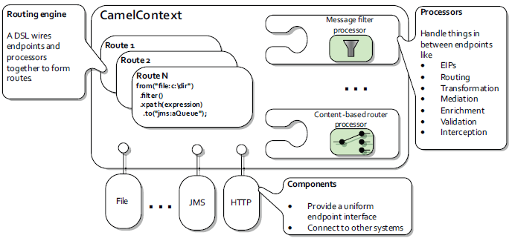
Arhitecture
At a high level, Camel is composed of processors, components, and routes.
All of these are contained within the CamelContext.
The routing engine uses routes as specifications for where messages are routed.
Processors are used to transform messages during routing and also to implement all the EIP patterns.
Components are the extension points in Camel for adding connectivity to other systems.

Slide 7
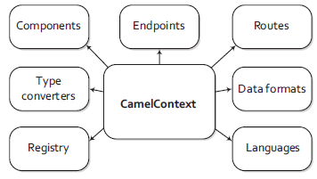
Camel Concepts
Camel Context
it's runtime container
Components
used by Camel. Can be loaded on the fly or discovered by OSGI.
Endpoints
models the end of the channel.
Routes
routes that are used by Camel.
Type converters
allows manually or automatic conversion from one type to another.
Data format
loaded data format
Processors
node capable of using, creating or modifying an incoming exchange.
Registry
registry that allows to lookup for beans. Uses default JNDI.
Languages
contains loaded languages.

Slide 8
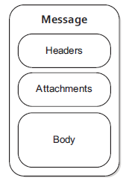

Message model
Messages are used by systems to communicate with each other when using channels.
Messages flow in one direction from a sender to a receiver.
There are two abstractions for modeling messages:
org.apache.camel.Message: basic entity containing data carried and routed
org.apache.camel.Exchange: has "in" message as request and "out" as reply.
Messages are uniquely identified with an identifier of type java.lang.String.
Messages also have a fault flag.

Slide 9
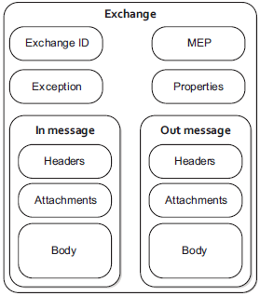
Message model (cont.)
An exchange in Camel is the message’s container during routing.
It provides support for interactions between systems, known as MEP.
MEPs(Message exchange pattern) are used to differentiate between one-way and request-response messaging styles.

Slide 10
Routes
Routes are core abstraction for Camel.
Routes can:
enhance features and functionality of systems.
allow clients and servers to be developed independently
provide a flexible way to add extra processing
decide dynamically what server a client will invoke
Each route in Camel has a unique identifier that’s used for logging, debugging, monitoring and starting and stopping routes.

Slide 11
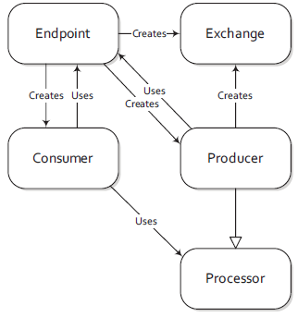
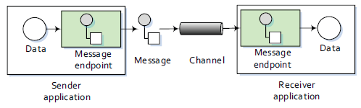
Endpoints
An endpoint is the Camel abstraction that models the end of a channel.
It acts as a neutral interface allowing systems to integrate
We configure endpoints using URIs and contains info like:
schema
context path
options
The endpoint acts as a factory for creating consumers and producers.

Slide 12
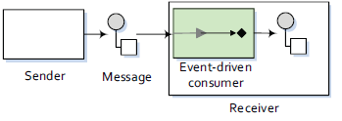
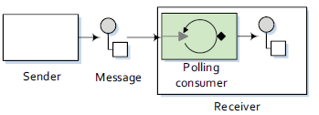
Endpoints (cont.)
Producer - creates and sends message to an endpoint.
Consumer - service that receives messages produced by a producer.
There are 2 types of consumers:
event-driven consumers
This kind of consumer is mostly associated with client-server architectures and web services.
It's referred as asynchronous receiver in EIP.
polling consumers
The polling consumer actively fetches messages from a particular source.
It's known as a synchronous receiver in EIP.

Slide 13
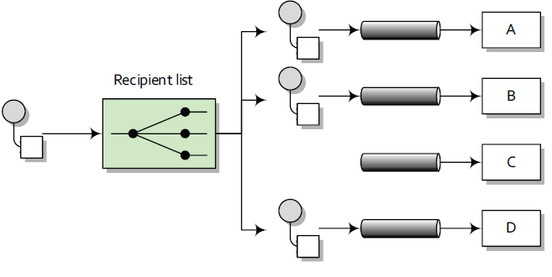
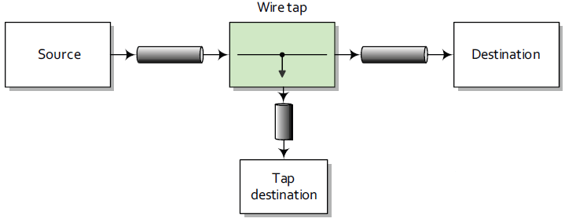
Endpoints (cont.)
Camel provides the recipientList() method for sending messages to a list of recipients.
A wire tap is a fixed recipient list that sends a copy of a message traveling from a source to a destination to a secondary destination.

Slide 14
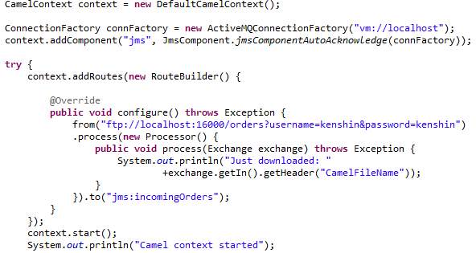
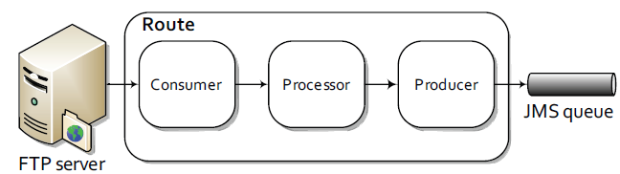
Examples
We can add on the fly Camel components like: FileComponent, FtpComponent, SftpComponent, JmsComponent.

Slide 15
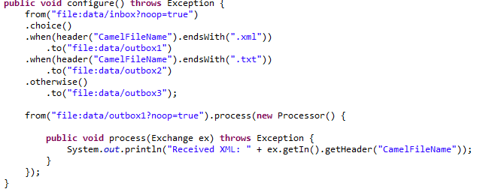
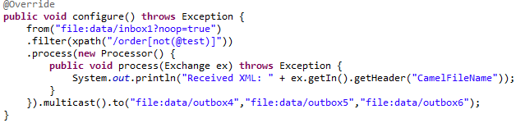
Examples (cont.)
We can create choices when routing.
We can filter messages by xpath expressions.
Messages can be sent to multiple endpoints using multicast().
When using multicasting, messages can be sent in parallel or serial.

Slide 16
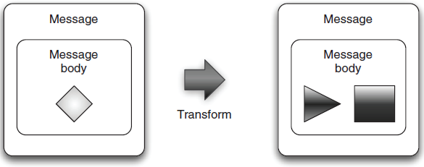
Data Transformation
Data transformation is a broad term that covers two types of transformation:
Data format transformation (ex: from cvs to xml)
Data type transformation (ex: from java.lang.String to javax.jms.TextMessage.)
Data transformation is used for mediate between protocols.
Camel has many data-transformation features.
Camel has 6 ways to transform data:
Data transformation in routes
Data transformation using components
Data transformation using data formats
Data transformation using templates
Data type transformation using Camel’s type converter mechanism
Message transformation in component adapters

Slide 17
Data Transformation (cont.)
For using Message Translator EIP Camel provides 3 ways:
Using a Processor - implement org.apache.camel.Processor, method: process(Exchange).
Using beans - use custom Bean with static String map(String) signature
Using <transform>
Camel uses the org.apache.camel.processor.AggregationStrategy interface to merge the results, method aggregate.
Data formats are pluggable transformers that can transform messages from one form to another and vice versa. The interface org.apace.camel.spi.DataFormat it's used and contains two methods: marshal and unmarshal.
The TypeConverterRegistry contains all the type converters are registered when Camel is started.
On startup, Camel loads all the type converters into the TypeConverterRegistry by using a classpath-scanning solution.

Slide 18
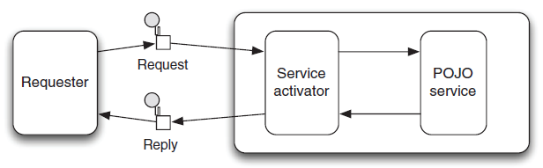
Registry
Camel can store beans into Registry.
The registry in Camel is merely a Service Provider Interface (SPI) defined in the org.apache.camel.spi.Registry interface:
SimpleRegistry - simple implementation
JndiRegistry - JNDI implementation
ApplicationContextRegistry - looks beans into Spring ApplicationContext.
OsgiServiceRegistry - looks for beans in the OSGI service reference registry.

Slide 19
Error handling
There are 2 categories of errors: recoverable and irrecoverable.
An irrecoverable error is represented as a message with a fault flag that can be set or accessed from org.apache.camel.Exchange.
Exceptions are represented as recoverable errors.
Fault messages are represented as irrecoverable errors.
Camel’s error handling only applies within the lifecycle of an exchange.
Error handlers:
DefaultErrorHandler: default error handler that’s automatically enabled.
DeadLetterChannel: Dead Letter Channel EIP.
TransactionErrorHandler: transaction-aware error handler extending the default error handler.
NoErrorHandler: used to disable error handling.
LoggingErrorHandler: logs the exception.
The default error handler is preconfigured and doesn’t need to be explicitly declared in the route.

Slide 20
Error handling (cont.)
Camel supports a redelivery mechanism that allows you to control how recoverable errors:
errorHandler(defaultErrorHandler().maximumRedeliveries(5).redeliveryDelay(10000).retryAttemptedLogLevel(LoggingLevel.WARN));
Headers on the Exchange related to error handling:
Exchange.REDELIVERY_COUNTER
Exchange.REDELIVERED
Exchange.REDELIVERY_EXHAUSTED
Camel will traverse the hierarchy from the bottom up to the root searching for an onException that matches the exception.
Camel can ignore exception if continued(true) is used: onException(ValidationException.class).continued(true);
Camel provides extra features for error handling:
onWhen: addapts Exception
onRedeliver: execute something before message is redelivered
retryWhile: allow to determine whether to continue redelivery

Slide 21
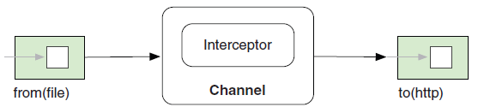
Testing
The Camel Test Kit provides JUnit extensions, Mock component, and producer template.
We can extend CamelTestSupport and override createRouteBuilder() to create routes.
We can extend CamelSpringTestSupport and override createApplicationContext().
MockEndpoint is used for creating mock endpoints.
expectedMessageCount(int)
expectedMinimumMessageCount(int)
expectedBodiesReceived(Object...)
expectedBodiesReceivedInAnyOrder(Order...)
assertIsSatisfied()
Techniques for simulating errors:
Processor
Mock
Interceptor
Intercept
interceptFromEndpoint
interceptSendToEndpoint

Slide 22
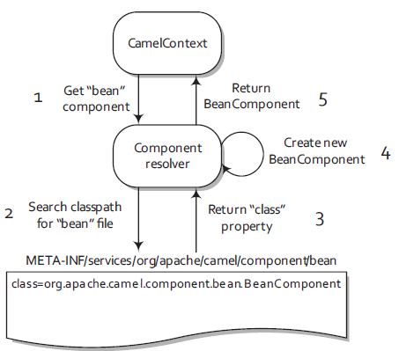
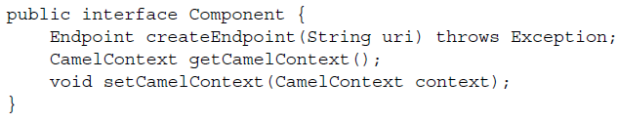

Components
Components are the primary extension point in Camel.
The main responsibility of a component is to be a factory for endpoints.
Components are added:
manually using addCompoment method from CamelContext.
using autodiscovery feature

Slide 23
Components (cont.)
Components from camel-core module:
Bean: invoked java bean in the registry
Browse: allows to browse the list of exchanges passed a browse endpoint.
DataSet: allows to create a large number of messages for load testing.
Direct: allow to call sync another endpoint
File: read/write files
Language: executes a script
Log: for logging
Mock: for testing
Ref: looks for endpoints in the registry
SEDA: allow to call async another endpoint.
Timer: send out messages at regular intervals
VM: call async another endpoint in the same JVM.

Slide 24
Testing
Camel provides a number of endpoints for testing:
DataSet – creates traffic, large number of messages for the routes
Mock – for testing routes and mediation rules
Test – creates Mock endpoints which expects to receive all the message bodies that could be polled from the given underlying endpoint
Camel also provides Spring Test integration.

Slide 25
Conclussion
PROS:
Simple to use and very powerful
Implements Enterprise Integration Patterns(EAP)
Has lots of components and provides an API for creating custom components
Documented and API
Provides Spring integration

Slide 26

Bibliography
http://en.wikipedia.org/wiki/Apache_Camel
Manning - Camel in Action

Slide 27
Questions ?

